Slide 1



Peter Eijgermans
@EijgermansPeter

Slide 3

Agenda
Component tree Building Tesla’s Battery Range Calculator
Explain Vue.js
Explain ReactJS

Slide 4
Building Tesla’s Battery Range Calculator with Vue

Slide 6
Tesla Battery Service

Slide 7
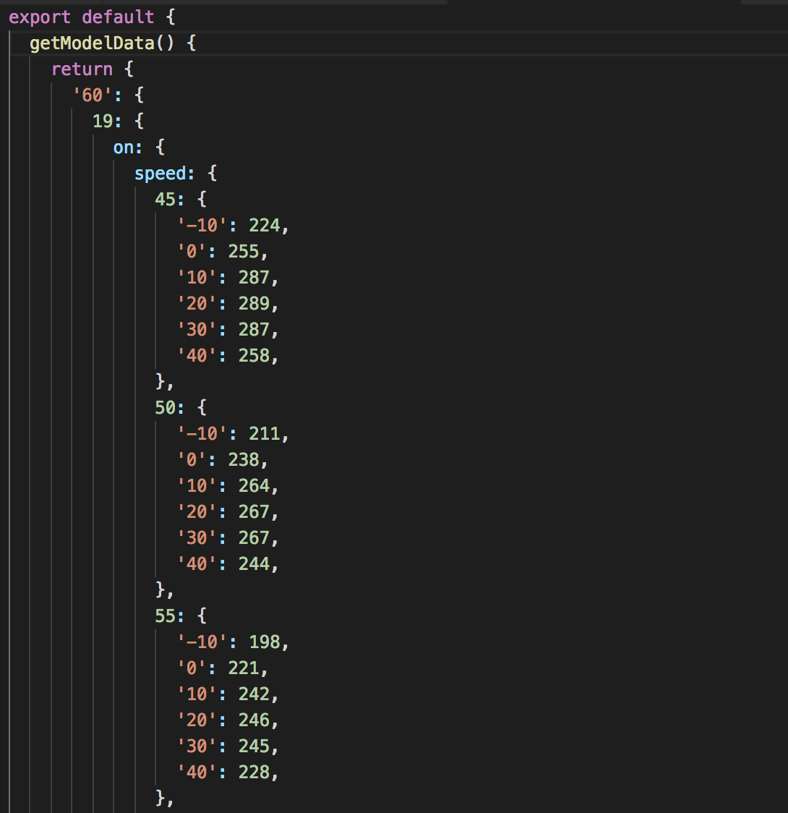
Notes:
The data we use is hard-coded and stored in tesla-battery.service.js.
This service has a getModelData() method for retrieving the model data.
The maximum battery range per Tesla model is based on the following parameters:
Tesla model (60, 60D ...)
Wheel size (19/20 inch)
Climate (on / off)
Speed
Temperature ( -10.0 ...)

Slide 8
Getting Started
https://github.com/petereijgermans11/workshop-reactjs-vuejs
@EijgermansPeter

Slide 9
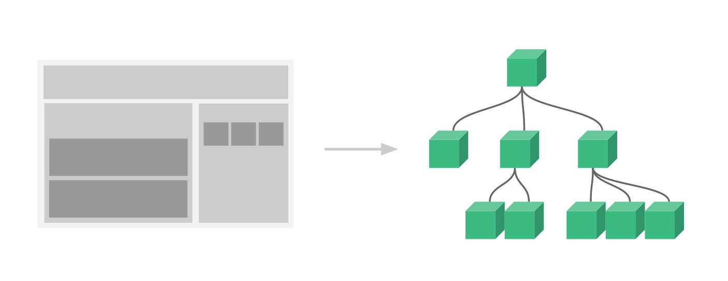

Component based
Integration with Angular or React
Small and compact (60 Kb)
Notes:
https://www.monterail.com/blog/vue-vs-react-2019
Components --> Allows you to break your application into smaller, reusable pieces
React = 100 kb
Angular = 500 kb

Slide 10
Startup Vue 2 with root Vue instance
var app = new Vue({
….
})
Notes:
To start with VueJS, we need to create the instance of Vue, which is called the root Vue Instance.

Slide 11
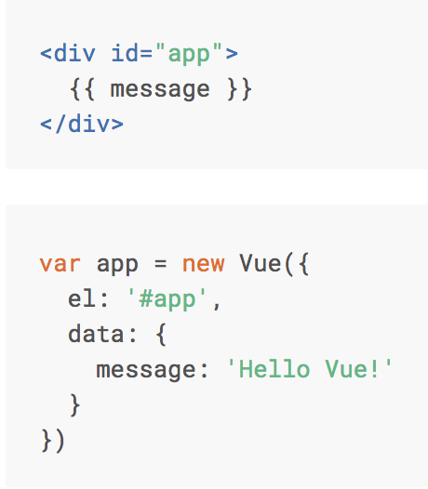

Basics Vue 2
Notes:
VUE 2
Here we create an instance of Vue.
For Vue, there is a parameter called el. It takes the id of the div-element.
Next, we have defined the data-object. The data-object => represents the MODEL => represents the STATE of your component
It has a property : message -> value: ‘message’
This value will be rendered in the View via ‘interpolation’ {{}}

Slide 12
Startup Vue 3 with createApp
Vue.createApp(Counter).mount('#counter')
Notes:
To start with VueJS, we need to create the instance of Vue, which is called the root Vue Instance.

Slide 13
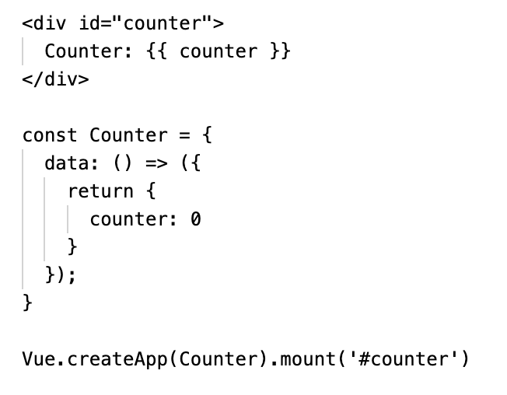
Basics Vue 3
Notes:
VUE 3
The way we bootstrap a new Vue app has changed. Rather than using new Vue(), we now need to import the new createApp method.
We then call this method, passing our Vue instance definition object, and assign the return object to a variable app.
Next, we'll call the mount method on app and pass a CSS selector indicating our mount element, just like we did with the $mount instance method in Vue 2.

Slide 14
Interpolation
<div> Counter: {{ counter }} </div>

Slide 15
Component based A component adds logic to DOM elements
Notes:
Components--> Allows you to break your application into smaller, reusable pieces

Slide 16
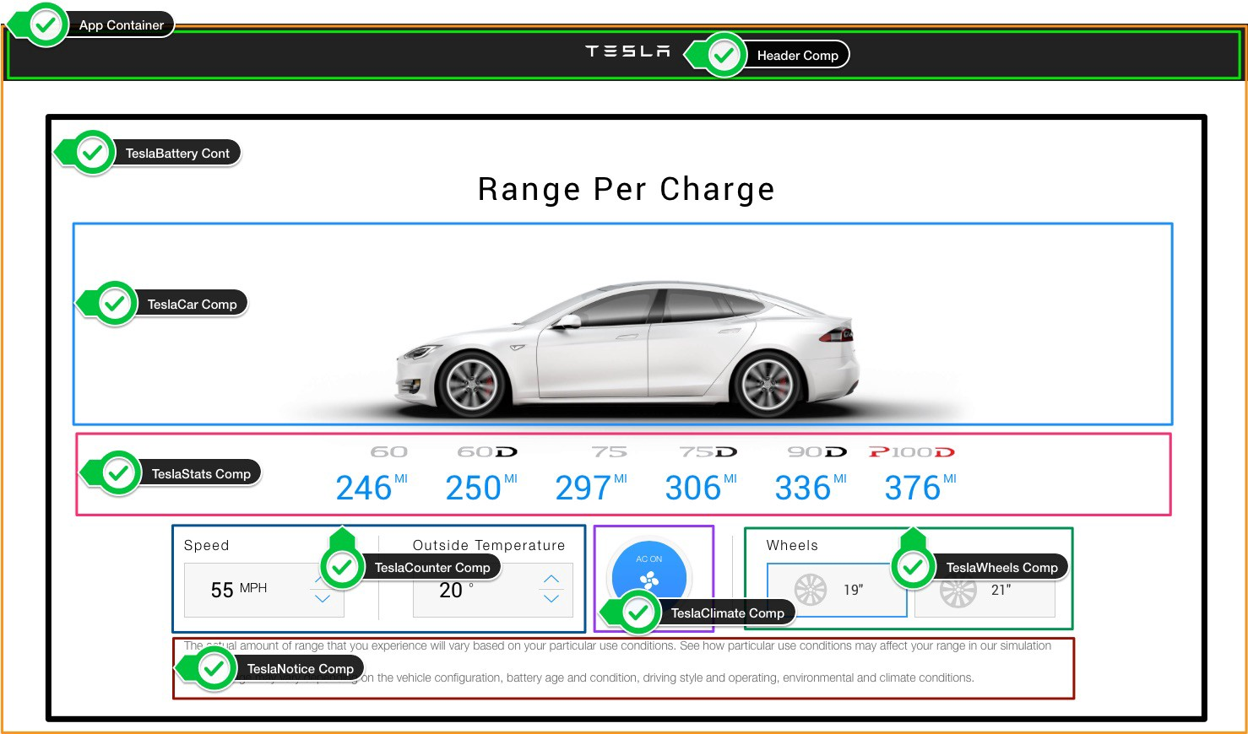

Slide 17
The UI is represented by a component tree
<App> --- Application entry point <TeslaHeader></TeslaHeader> <TeslaBattery> --- Container Component <TeslaCar /> --- Presentational Component <TeslaStats /> --- Presentational Component <TeslaCounter /> --- Presentational Component <TeslaClimate /> --- Presentational Component <TeslaWheels /> --- Presentational Component <TeslaNotice /> --- Presentational Component </TeslaBattery> </App>
Notes:
Container components:
Provides Data and managing the State
Passing this data via props to child components
Performing actions/logic via callback functions (to change the state)
Presentational components:
Dump components → Buttons, inputs, headers, rendering images (example TeslaCar → rendering car - image)
Receive data via props
Return data to parent components through an event
Advantages:
Reusability
Dumb components are easier to test
Easier to understand and maintain

Slide 18
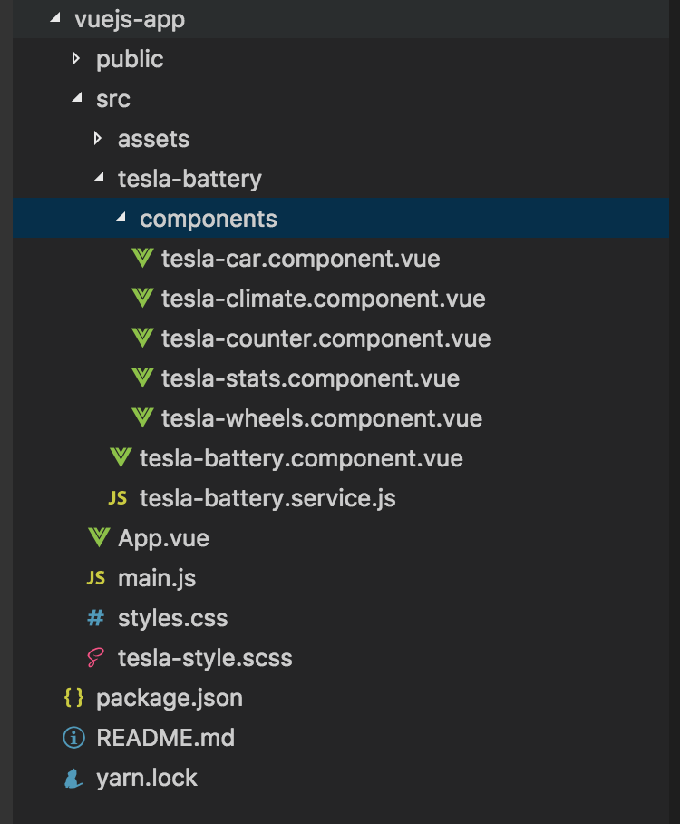

Slide 19
Components tree
main.js
App.vue
TeslaBattery
→ Container Component
props
props
props
props
props
TeslaCar
TeslaStats
TeslaCounter
TeslaClimate
TeslaWheels
Presentational Components

Slide 20
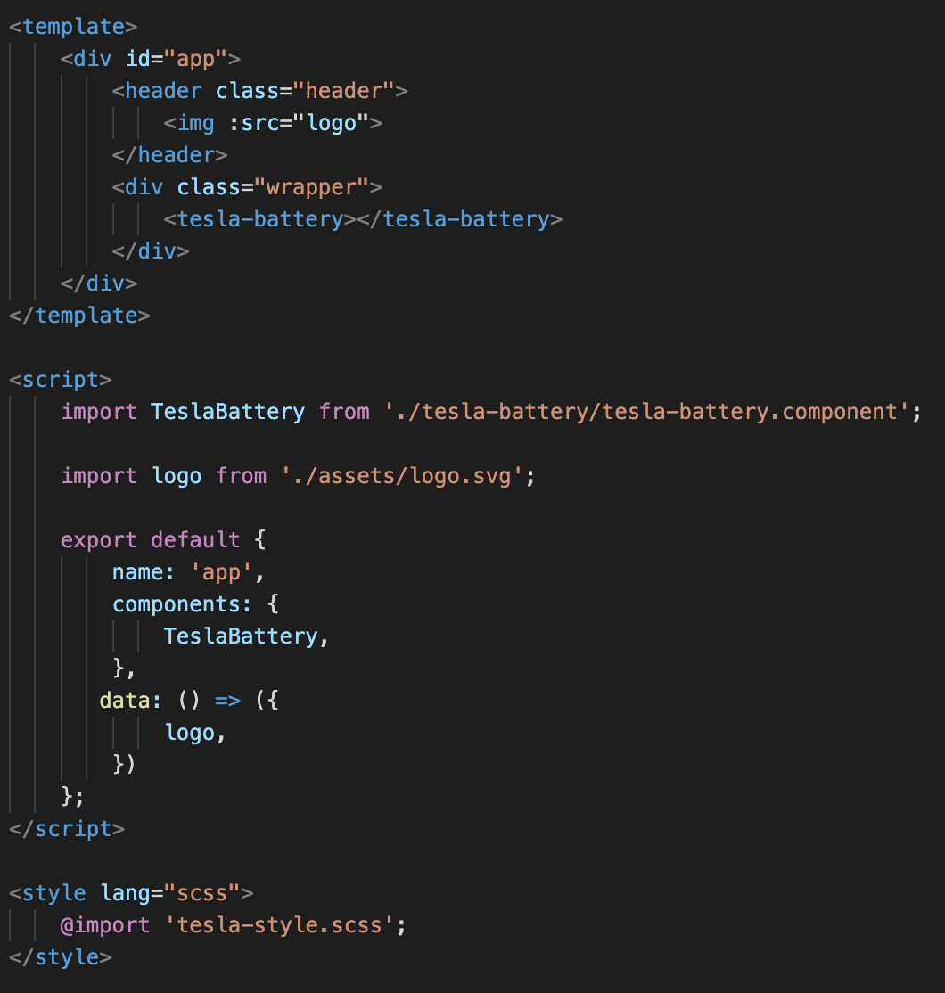
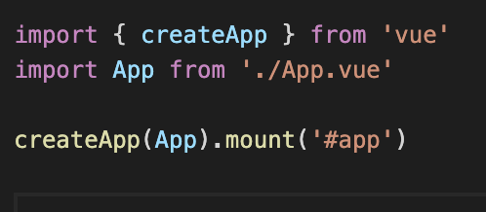
Entry Point
main.js
App.vue
Notes:
main.js
Is the entry point of the application, it is here that your first component (App.vue) is mounted and rendered.
Steps:
Imports
Create a "root Vue instance”
From this "root Vue instance," render the imported App.vue component
Finally, this root Vue instance is mounted. This is the point where the application is started. This refers to an HTML element with the identification #app in the App.vue component.
-----
App.vue
Is the first component mounted by Vue.
Consists of the following parts: Script, Template and Style
Script:
Properties: name, components, data()-function
imports
Template:
Defining the output of the component.
Data from the data ()-function can be easily rendered through data binding
Example: assign the logo to the img src-attribute, via attribute binding → see img-tag → colon !!!
Finally: TeslaBattery component is instantiated and rendered using the <tesla battery>-tag

Slide 21
Components tree
Main.js
App.vue
TeslaBattery
props
props
props
props
props
TeslaCar
TeslaStats
TeslaCounter
TeslaClimate
TeslaWheels

Slide 22
Tesla Battery Component
Provides:
data = state
props
actions (changes state)
Notes:
Tesla Battery Component
Provides Data and managing the State
Passing this data via props to child components
Performing actions/logic via callback functions (to change the state)

Slide 23
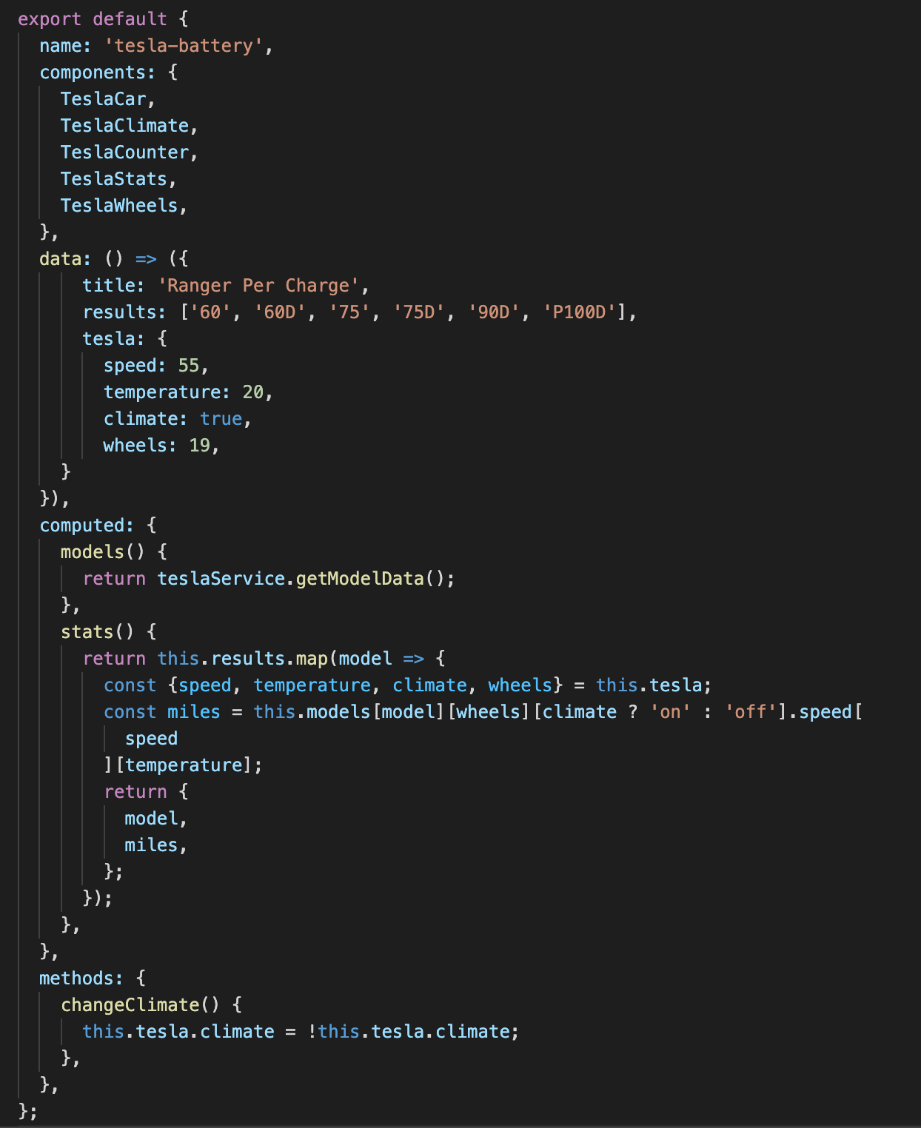
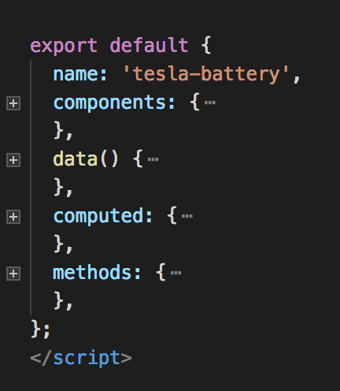
Tesla Battery Component
stats()
[
{"model":"60","miles":267},
{"model":"60D","miles":271},
{"model":"75","miles":323},
{"model":"75D","miles":332},
{"model":"90D","miles":365},
{"model":"P100D","miles":409}
]
Notes:
This is the container component.
The tesla-battery.component: Provides data and actions to child/presentational components.
COMPUTED vs METHODS:
The computed property contains the functions that are cached. That is, such a function is only executed if it depends on a specific data property and when the state of this property changes.
Example: stats-function
This ‘stats-function’ filters the maximum battery range per Tesla model from the model data.
This maximum battery range is based on user input, such as the selected wheel size, climate, speed, and temperature. And this stats()-function is only executed if this user input changes.
The user input is recorded in the tesla object (state object), which is defined in the data()-function.

Slide 24
Output stats()-function
[
{"model":"60","miles":267},
{"model":"60D","miles":271},
{"model":"75","miles":323},
{"model":"75D","miles":332},
{"model":"90D","miles":365},
{"model":"P100D","miles":409}
]

Slide 25
Notes:
The data we use is hard-coded and stored in tesla-battery.service.js.
This service has a getModelData() method for retrieving the model data.
The maximum battery range per Tesla model is based on the following parameters:
Tesla model (60, 60D ...)
Wheel size (19/20 inch)
Climate (on / off)
Speed
Temperature ( -10.0 ...)

Slide 26
State of the App
stats()-function: calculating the maximum battery range per model. This range is based on the user input (wheelsize – climate – speed - temp)
tesla (object): Currently selected conditions (speed: 55, temperature: 20, climate: on, wheel: 19)

Slide 27
Tesla Stats Component

Slide 28
Passing props to child components
Main.js
Use v-bind or :
to pass props
App.vue
TeslaBattery
props
props
:stats
props
props
props
TeslaCar
TeslaStats
TeslaCounter
TeslaClimate
TeslaWheels
Notes:
Colon is ‘:’

Slide 30
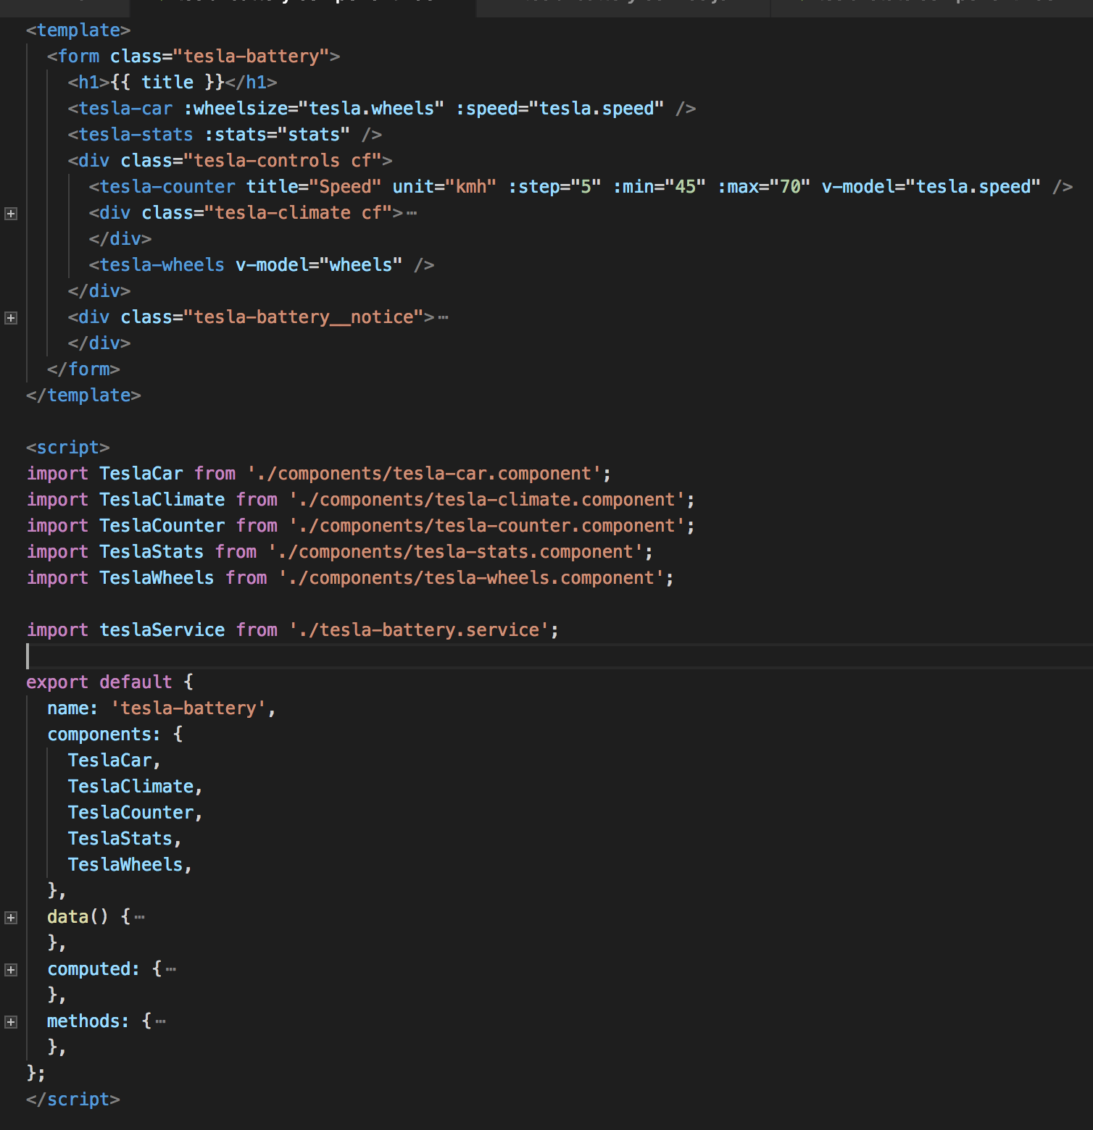
Tesla Battery Component Passing props/data to Tesla Stats Component
:stats = Array
[
{"model":"60","miles":267},
{"model":"60D","miles":271},
{"model":"75","miles":323},
{"model":"75D","miles":332},
{"model":"90D","miles":365},
{"model":"P100D","miles":409}
]
Notes:
To pass data to a child component, you must use v-bind:stats or :stats in the template

Slide 31
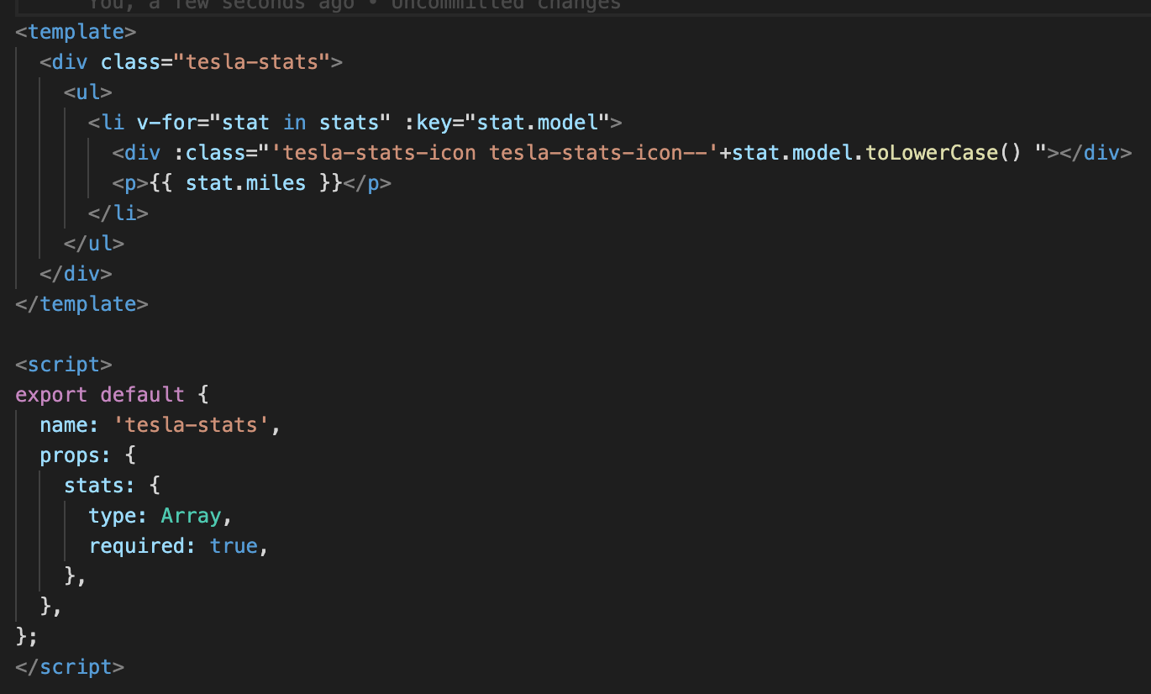
Receiving data in Tesla Stats Component
v-for=“stat in stats” :key
stats (type: Array)

Slide 32
Components are like JavaScript functions
fn(d) = V
Notes:
Component = A function that receives data as input and returns a view.

Slide 33
v-model
2-way databinding

Slide 34
2-way databinding
App.vue
props
TeslaHeader
TeslaBattery
props
props
props
props
:speed
$emit
speed
TeslaCar
TeslaStats
TeslaCounter
TeslaClimate
TeslaWheels

Slide 35
v-model (2-way databinding)
Components compatible with v-model:
accept a :modelValue property
emit an @update:modelValue event
Notes:
emit an @input event when the user changes the value

Slide 36
Tesla Counter Component

Slide 37
v-model Tesla Battery to Tesla Counter
v-model=“tesla.speed”

Slide 38
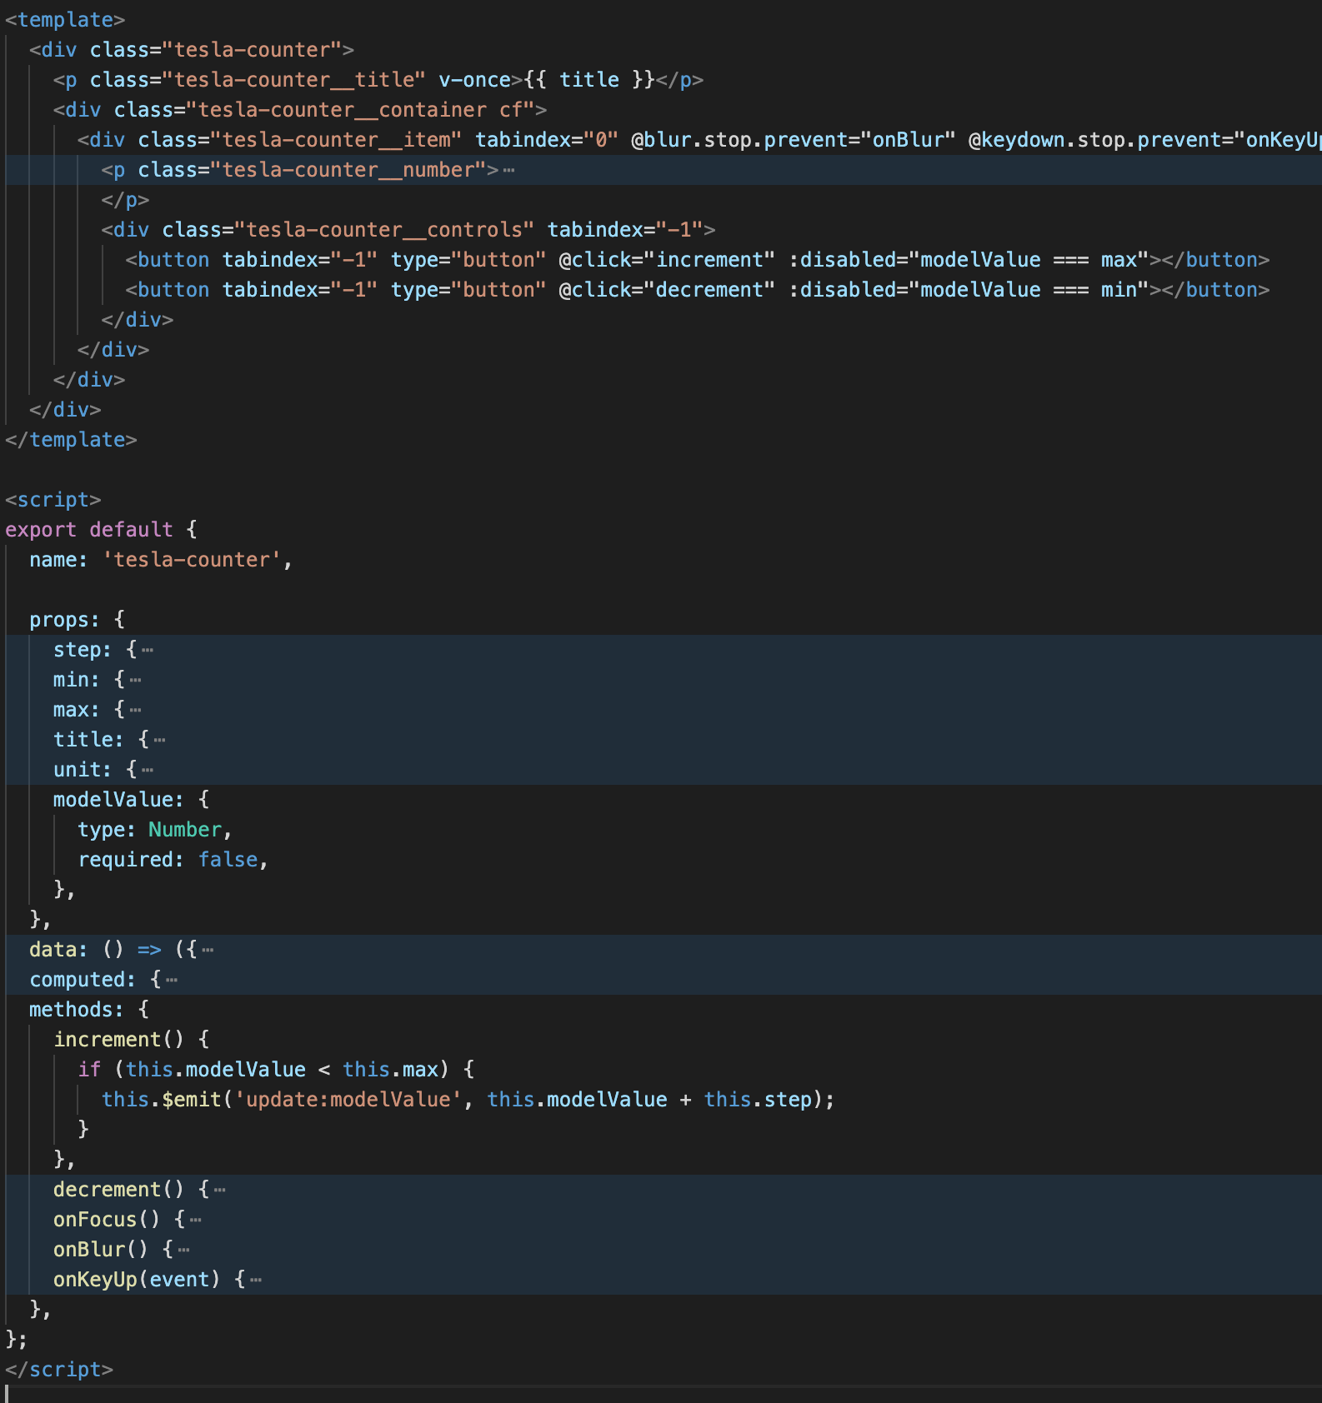
v-model in Tesla Counter Component
@click =“increment”
prop: modelValue
this.$emit(‘update:modelValue’, this.modelValue)
Notes:
The value/speed is emitted back to the parent component

Slide 39
Composition API
What and Why?
The organization of component logic.
Reuse logic
Notes:
You are not forced to use the composition API it’s optional.
function-based APIs that allow flexible composition of component logic

Slide 40
Composition API
How?
Create a javascript file, referred to as a composable which contains functions
Import the composable into a component and add a setup() method
Notes:
Create a javascript file, referred to as a composable, which exports the data and methods you want your components to have access to.
Import the composable into a component and add a setup() method, in which you can import the data and methods exported by the composable.

Slide 41
Tesla Stats Component - Old

Slide 42
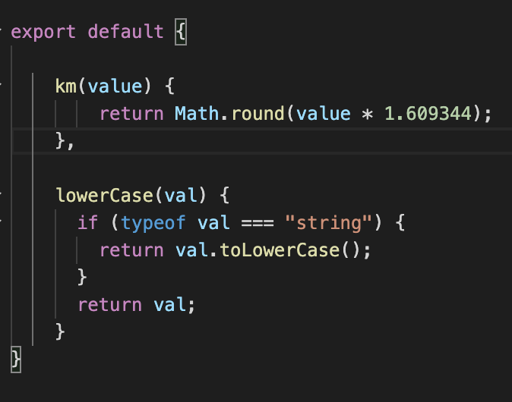
Create a javascript file = Composable
filters.js

Slide 43
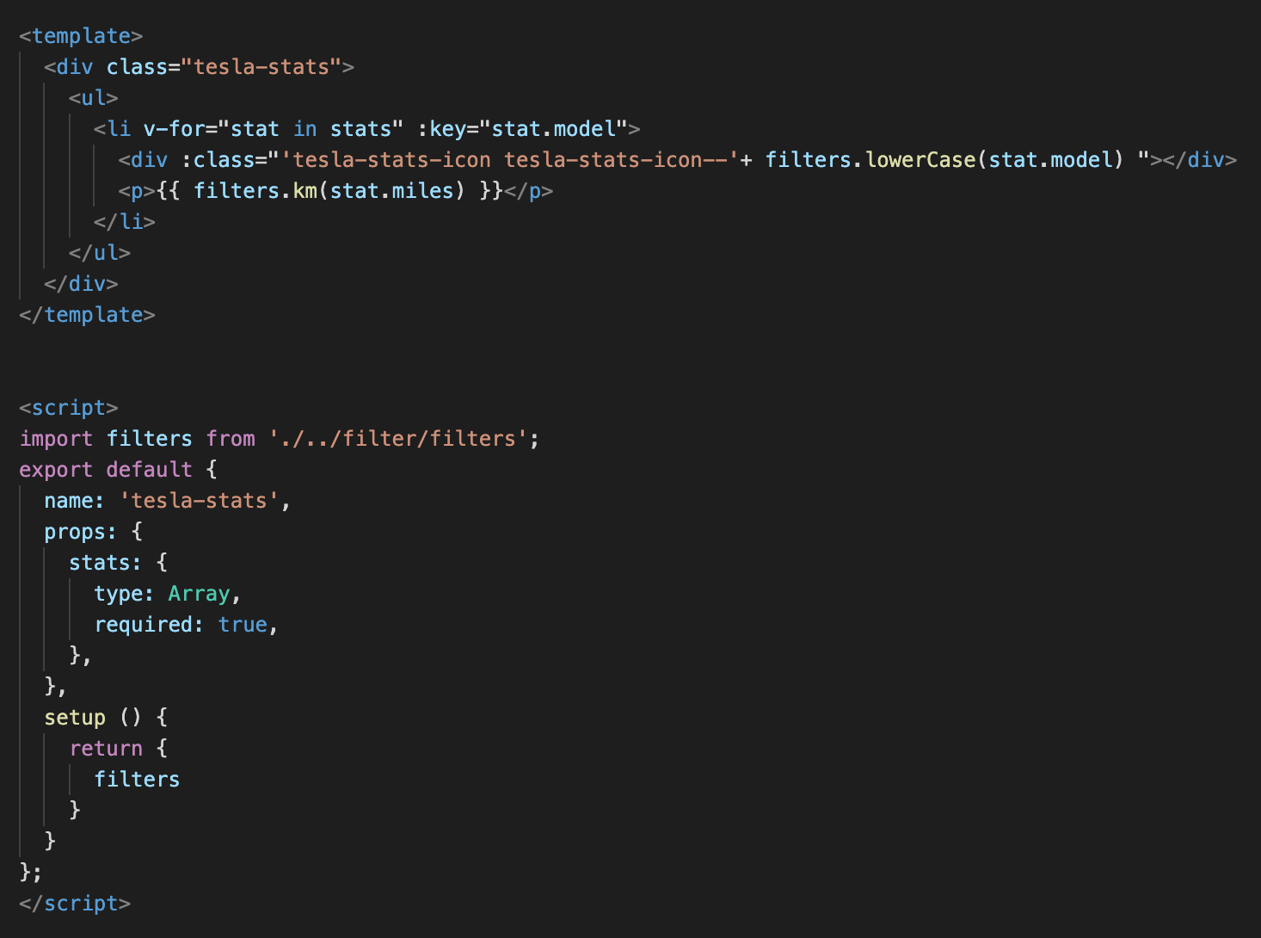

Slide 44

Notes:
http://coenraets.org/present/react/#3.
http://slides.com/alexanderfarennikov/react-js-fundamentals/fullscreen#/20
https://scotch.io/tutorials/learning-react-getting-started-and-concepts

Slide 46
Syntax Component
class Welcome extends React.Component {
render( ) {
}
}
IN HTML:
<Welcome />
Notes:
Component = main building block React.
COMPONENT
Here, Welcome is a React component class. Always start component names with a capital letter.
A component takes in parameters, called props, and returns a (hierarchy of) views to display via the render method.
JSX:
The view: is a combination of HTML and Javascript!!! Called JSX
You can embed any JavaScript expression in JSX by wrapping it in curly braces.
----------------
Conceptually, components are like JavaScript functions. They accept arbitrary inputs (called "props") and return React elements describing what should appear on the screen.
Always start component names with a capital letter.
For example, <div /> represents a DOM tag, but <Welcome /> represents a component and requires Welcome to be in scope.

Slide 47
Syntax Component
class Welcome extends React.Component{
render( ) {
return <div>Hello { this.props.name } </div>; → JSX
}
}
IN HTML:
<Welcome name="Sarah" />
Hello Sarah
Notes:
Component = main building block React.
COMPONENT
Here, Welcome is a React component class. Always start component names with a capital letter.
A component takes in parameters, called props, and returns a (hierarchy of) views to display via the render method.
JSX:
The view: is a combination of HTML and Javascript!!! Called JSX
You can embed any JavaScript expression in JSX by wrapping it in curly braces.
----------------
Conceptually, components are like JavaScript functions. They accept arbitrary inputs (called "props") and return React elements describing what should appear on the screen.
Always start component names with a capital letter.
For example, <div /> represents a DOM tag, but <Welcome /> represents a component and requires Welcome to be in scope.

Slide 48
Components are like JavaScript functions
fn(d) = V
Notes:
Conceptually, components are like JavaScript functions.
They accept arbitrary inputs (called "props") and return React elements describing what should appear on the screen.
Component = A function that receives data as input and returns a view.

Slide 49
Component: class
2 types of state:
this.props
Get input properties from parent component
this.state
Local state within components

Slide 50
export class Welcome extends React.Component {
render( ) {
return <h1>Hello { this.props.name }</h1>;
}
}
class App extends React.Component {
render( ) {
return (
<div>
<Welcome name="Sarah" />
<Welcome name=”Ellis" />
<Welcome name=”Maria" />
</div>
);
}
}
ReactDOM.render(
<App />, document.getElementById('root')
);
<div id="root"></div>
Hello Sarah Hello Ellis Hello Maria
Notes:
Export?

Slide 51
this.props
Never changes props!
This is the responsibility for the parent

Slide 52
Components

Slide 53
The UI is represented by a component tree
<App> --- Application entry point <Header></Header> <TeslaBattery> --- Container Component <TeslaCar /> --- Presentational Component <TeslaStats /> --- Presentational Component <TeslaCounter /> --- Presentational Component <TeslaClimate /> --- Presentational Component <TeslaWheels /> --- Presentational Component <TeslaNotice /> --- Presentational Component </TeslaBattery> </App>

Slide 54
Project structure

Slide 55
Components tree
Index.js
App.js
Header
TeslaBattery
→ Container Component
props
props
props
props
props
TeslaCar
TeslaStats
TeslaCounter
TeslaClimate
TeslaWheels
Presentational Components

Slide 56
App.js component
import Header from './components/Header’;
class App extends React.Component { render() { return ( <div className="App"> <Header /> </div> ); } }

Slide 57
Header

Slide 58
Header component
import React from 'react'; import './Header.css'; import logoUrl from '../../assets/logo.svg’;
const Header = ( ) => ( <div className=“header"> <img src={logoUrl} alt="Tesla" /> </div> )
export default Header;
Notes:
Here, the component is in the form of a function (ES6 Arrow Function). A component declared in this form is called a functional component. If there is no state and the lifecyclemethod is not needed, it is a good pattern to declare it as a function type.
Functional components are suitable for Presentational Component because they have no state and they depend only on the props that is received from higher components.

Slide 59
Components tree
Index.js
App.js
Header
TeslaBattery
→ Container Component
props
props
props
props
props
TeslaCar
TeslaStats
TeslaCounter
TeslaClimate
TeslaWheels
Presentational Components

Slide 60
Tesla Battery Component
Provides:
data = state
props
actions (changed state)
Notes:
Tesla Battery Component
Provides data
Passing this data via props to child components
Performing actions via callback functions (to change the state)

Slide 61
class TeslaBattery extends React.Component { constructor () { super( );
this.state = { carstats: [ ], config: { speed: 55, temperature: 20, climate: true, wheels: 19 } } } render( ) { const { config } = this.state; return ( <form className="tesla-battery"> <h1>Range Per Charge</h1> <TeslaCar /> </form> ) } }
Notes:
STATE
To initialize the state, simply set this.state in the constructor() method of the class.
carstats
config
SUPER()
Before we set the state, we have to call super() in the constructor.
This is because ’this’ is uninitialized before super() has been called.
Example destructuring: const { config } = this.state;
It takes the required value out of the object and makes a reference to it.
The TeslaCar Component accepts the wheelsize input through props and renders the Tesla car image and spins the wheels.
-----

Slide 62
State of the App
carstats (object array) : contains the maximum battery range per model. This range is based on the user input (wheelsize – climate – speed - temparature)
config (object): Currently selected conditions object (speed: 55, temperature: 20, climate: aricon on, wheel: 19)

Slide 63
carstats
[
{"model":"60","miles":267},
{"model":"60D","miles":271},
{"model":"75","miles":323},
{"model":"75D","miles":332},
{"model":"90D","miles":365},
{"model":"P100D","miles":409}
]

Slide 64
Tesla Battery Service

Slide 65
Notes:
Models
–> wheelsize
–> climate on/off
–> speed
--> temparature

Slide 66
Tesla Car Component

Slide 67
Passing props to Tesla Car Component
Index.js
App.js
Header
TeslaBattery
→ Container Component
props
props
wheelsize
props
props
props
TeslaCar
TeslaStats
TeslaCounter
TeslaClimate
TeslaWheels
Presentational Components

Slide 68
Tesla Battery Component
class TeslaBattery extends React.Component { constructor () { super( );
this.state = { carstats: [], config: { speed: 55, temperature: 20, climate: true, wheels: 19 } } }
render( ) { const { config } = this.state; return ( <form className="tesla-battery"> <h1>Range Per Charge</h1> <TeslaCar wheelsize={config.wheels}/> </form> ) } }
wheelsize
Notes:
Example destructuring: const { config } = this.state;
It takes the required value out of the object and makes a reference to it.
ow we will add the constructor method to the TeslaBattery container and set the initial value so that we can manage this state value and pass it to the subcomponent. The TeslaCarcomponent accepts the wheelsize input through props and renders the Tesla car image and spins the wheels.
-----
Before we set the state, we have to call super() in the constructor. This is because this is uninitialized before super() has been called.

Slide 69
Receiving props in Tesla Car Component

Slide 70
Receiving props in Tesla Car Component
const TeslaCar = (props) => ( <div className="tesla-car"> <div className="tesla-wheels"> <div className={`tesla-wheel tesla-wheel--front tesla- wheel--${props.wheelsize}`}></div> <div className={`tesla-wheel tesla-wheel--rear tesla- wheel--${props.wheelsize}`}></div> </div> </div> );
TeslaCar.propTypes = { wheelsize: React.PropTypes.number }
export default TeslaCar;

Slide 71
Changing State

Slide 72
Changing State
Do not! Change state with:
this.state = newState
Use:
this.setState( { … } )
Or use:
React Hooks !!!
Notes:
Otherwise react will not re-render, and possibly overwrite your state.

Slide 73

class WelcomeStatefull extends React.Component { constructor(){ super(); this.state = { message: "my friend !!" }; } render( ) { return <h1>Hello {this.state.message}!</h1>; } }
→ JSX
Notes:
To initialize the state, simply set this.state in the constructor() method of the class.
Our state is an object which in our case only has one key called message.
SUPER()
Before we set the state, we have to call super() in the constructor.
This is because ’this’ is uninitialized before super() has been called.

Slide 74

class WelcomeStatefull extends React.Component { constructor(){ super(); this.state = { message: "my friend !" }; this.updateMessage = this.updateMessage.bind(this); }
updateMessage( ) { this.setState({ message: "my friend (from changed state)!" }); }
render( ) { return ( <div> <h1>Hello {this.state.message}!</h1> <button onClick={this.updateMessage}>Click me!</button> </div> ) } }
Notes:
Changing the state
To modify the state, simply call this.setState(), passing in the new state object as the argument.
We’ll do this inside a method which we’ll call updateMessage.
Note: To make this work, we also had to bind the ’this’ keyword to the updateMessage method. Otherwise we couldn’t have accessed this in the method.
The next step is to create a button to click on, so that we can trigger the updateMessage() method.
The updateMessage method then calls this.setState() which changes the this.state.message value.

Slide 76
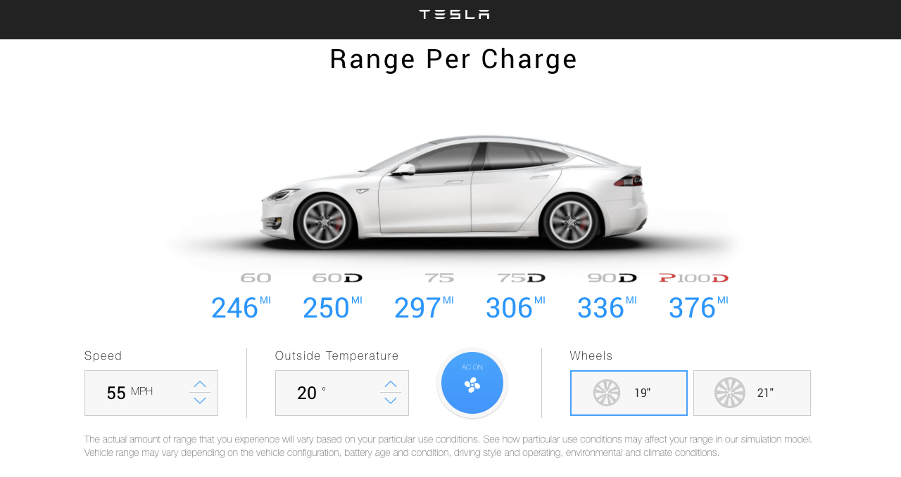
Recalculate STATS when Wheelsize changes

Slide 77
class TeslaBattery extends React.Component { constructor () { super( );
this. handleChangeWheels = this. handleChangeWheels.bind(this);
this.state = { carstats: [], config: { speed: 55, temperature: 20, climate: true, wheels: 19 } } }
handleChangeWheels(size) { this.state.config.wheels = size;
this.setState( { config }, () => { this.statsUpdate() } ) }
render( ) { const { config } = this.state; return ( <form className="tesla-battery"> <h1>Range Per Charge</h1> <TeslaWheels value={config.wheels}
handleChangeWheels={ this.handleChangeWheels }
/>
</form> ) } }
carstats = [
{"model":"60","miles":267},
{"model":"60D","miles":271},
{"model":"75","miles":323},
{"model":"75D","miles":332},
{"model":"90D","miles":365},
{"model":"P100D","miles":409}
]
Notes:
THIS EXAMPLE PASSES A CALLBACK FUNCTION TO THE CHILD COMPONENT (Tesla Wheels) and CHANGED THE CALCULATED STATS for the: Changed wheels !!!
Read also : https://reactjs.org/docs/state-and-lifecycle.html
it is possible to update the config object first in setState(), which operates asynchronous method, and to render the changed stats on the screen based on this, see:
this.setState( { config }, () => { this.statsUpdate() } )
-----------
Example destructuring: const { config } = this.state;
It takes the required value out of the object and makes a reference to it.
Now we will add the constructor method to the TeslaBattery container and set the initial value so that we can manage this state value and pass it to the subcomponent.
The TeslaWheels component accepts the wheelsize input through props and renders the size of the Tesla Wheels image
-----
Before we set the state, we have to call super() in the constructor. This is because ’this’ is uninitialized before super() has been called.

Slide 78
Component Lifecycle
Mounting
Updating
Unmounting

Slide 79
React Hooks
Hooks are functions that let you “hook into” React state and lifecycle features from function components.
Notes:
Hooks don't work inside classes — they let you use React without classes. ... You can also create your own Hooks to reuse stateful behavior between different components.

Slide 80
useState hook
function TeslaBattery (props) {
const [carstats, setCarstats] = useState([]);
const [config, setConfig] = useState ({
speed: 55,
temperature: 20,
climate: true,
wheels: 19
});
constructor(props) {
super(props);
this.state = {
carstats: [],
config: {
speed: 55,
temperature: 20,
climate: true,
wheels: 19
}
}
}

Slide 81
Replace this.setState()
class TeslaBattery extends React.Component {
statsUpdate() {
const carModels = ['60', '60D', '75', '75D', '90D', 'P100D'];
this.setState ({
carstats: this.calculateStats(carModels, this.state.config)
})
}
Notes:
this.setState obviously doesn't exist any more in our function component. Instead we need to replace each of our setState calls with the relevant state variable setter.

Slide 82
With set….
function TeslaBattery (props) {
const [carstats,setCarstats] = useState([]);
const statsUpdate = () => {
const carModels = ['60', '60D', '75', '75D', '90D', 'P100D'];
setCarstats(calculateStats(carModels, config));
}
Notes:
this.setState obviously doesn't exist any more in our function component. Instead we need to replace each of our setState calls with the relevant state variable setter.

Slide 83
Demo React Hooks
See article:
https://dzone.com/articles/steps-to-convert-the-react-tesla-battery-range-calc-to-func-comp-with-hooks

Slide 84
Comparison
Notes:
Virtual DOM is the representation of DOM as an object. When changes to state of application are made, new Virtual DOM is compared(applying diffing algorithms) with DOM and only changes are reflected, not causing full re-rendering of DOM.
Components --> Allows you to break your application into smaller, reusable pieces

Slide 85
React
Facebook
React Native
React uses plain JavaScript
100 kb
Moderate
A lot of coding
More developers available
Vue
Community
Vue Native / NativeScript
Solutions like: Directives, Routing
60kb
Easier
Less code
Less developers
Notes:
React is less opinionated, e.g., unlike Vue, it doesn’t force specific solutions for things like, Directives, routing and state management. This makes React a more flexible framework,
Tesla Battery:
React 160 lines of code
Vue 80 lines of code

Slide 86
Similarities
Both use Virtual DOM
Same performance
Component based
Notes:
Virtual DOM is the representation of DOM as an object. When changes to state of application are made, new Virtual DOM is compared(applying diffing algorithms) with DOM and only changes are reflected, not causing full re-rendering of DOM.
Components --> Allows you to break your application into smaller, reusable pieces

Slide 87
Links
https://github.com/petereijgermans11/workshop-reactjs-vuejs
https://dzone.com/articles/build-a-tesla-battery-range-calculator-yourself-it
https://www.freecodecamp.org/news/building-teslas-battery-range-calculator-with-react-part-1-2cb7abd8c1ee/
@EijgermansPeter

Slide 88

@EijgermansPeter

